Slide 1
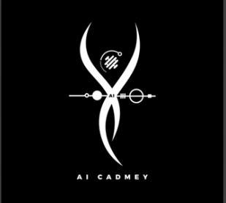
AIC PROJECT
BY: ALISHA BABAR

Slide 2
Documentation: To-Do List Application
Introduction
The To-Do List Application is a simple console-based program written in Python. It allows users to manage tasks efficiently by providing options to add, view, mark as completed, and delete tasks. The application runs in a loop until the user chooses to exit.

Slide 3
Features
View Tasks:
Displays all tasks in the to-do list along with their completion status.
Tasks marked as completed show a ✔, while pending tasks show a ✘.
Add Task:
Enables the user to add a new task to the list.
Prevents duplicate tasks from being added.
Mark Task as Completed:
Lets the user mark a specific task as completed by selecting its number from the list.
Delete Task:
Allows the user to remove a specific task from the list by selecting its number.
Exit:
Exits the application and displays a goodbye message.

Slide 4
How to Use the Application
Start the Program:
Run the script in a Python environment.
Navigate the Menu:
The main menu displays five options:
View Tasks
Add Task
Mark Task as Completed
Delete Task
Exit
Follow Prompts:
Enter the corresponding number (1-5) for the desired action.
Provide additional input (e.g., task description, task number) when prompted.
Exit the Application:
Choose option 5 to exit the program.

Slide 5
SUMMARY
The To-Do List Application is a beginner-friendly Python program designed to manage tasks effectively. It operates via a console-based interface, allowing users to interact with a simple menu system to perform various actions such as viewing tasks, adding new tasks, marking tasks as completed, and deleting tasks.

